Slide 1
Correlation

Slide 2
Linear Correlation
In this course we will be looking at linear correlation.
We measure the strength of the linear relationship between two quantitative random variables (each with at least an interval scale level of measurement).
Researchers often wish to determine whether two variables are related.
For example, a researcher might be interested in knowing whether there is a relationship between how long people live (longevity) and the number of calories consumed per day.
Or, between hours spent on the Internet and high school average;
or hours spent studying and grades on a statistics final.
These are situations where correlation might be appropriate.

Slide 3
Linear Correlation
We will use a simple formula to compute r, the correlation coefficient, from sample data. This correlation coefficient, r, ranges from -1 to +1.
An r of +1 indicates a perfect positive linear relationship.
An r of -1 indicates a perfect negative linear relationship.
An r of 0 indicates absolutely no linear relationship.
r, the sample correlation coefficient is an estimate of the population correlation coefficient, ρ (rho). We can compute ρ only if we take a census of the entire population.

Slide 4
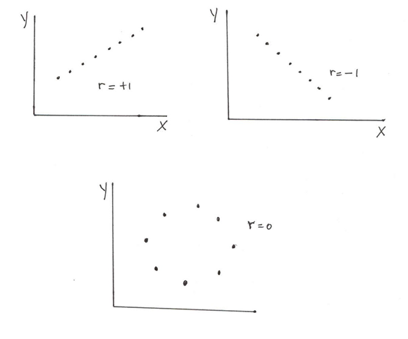
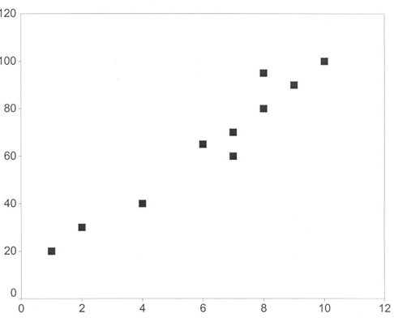
A Positive Relationship
A correlation of coefficient, r, of +1 indicates a perfect positive linear relationship between the two variables.
In fact, if we draw a scatter plot placing all the paired sample data on a graph, all the points would lie on a straight line.
Of course, in real life, one almost never encounters perfect relationships between variables. For instance, it is certainly true that there is a very strong positive relationship between hours studied and grades. However, there are other variables that affect grades as well. Two students can each spend 20 hours studying for an exam and one will get a 100 on the exam and the other will get an 80. This indicates that there is also random variation and/or other variables that explain performance on a test (e.g., IQ, previous knowledge, test taking ability, etc.).

Slide 5
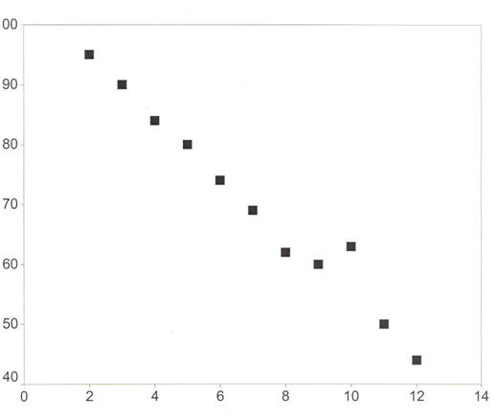
A Negative Relationship
A correlation of -1 indicates a perfect negative linear relationship (i.e., an inverse relationship).
In fact, in a scatter plot, all the points would lie on a line with a downward slope.
Of course, as before, there are no perfect relationships in the real world. The scatter plot pictured here shows a strong negative linear relationship.

Slide 6
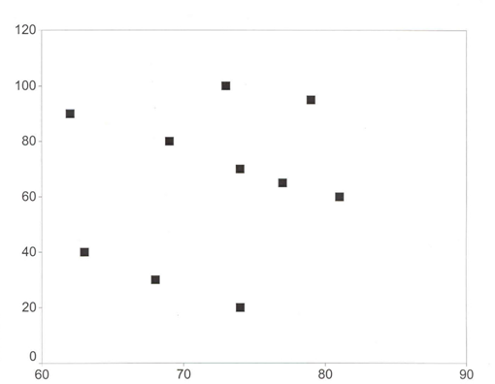
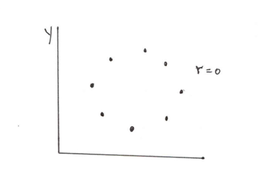
No Linear Correlation (r = 0)
A correlation of 0 indicates absolutely no relationship between X and Y. In real life, correlations of 0 are very rare. You might, rather, get a correlation of .10 and it will not be significant, i.e., it is not statistically different from 0. (There are ways to test correlations for significance.)
no linear relationship
no relationship at all

Slide 7
Correlation and Causality
EXAMPLES
Poverty and crime are correlated. Which is the cause?
3 % of older singles suffer from chronic depression; does being single cause depression? Perhaps, being depressed results in one being single. People do not want to marry unhappy people.
Cities with more cops also have more murders. Does ‘more cops’ cause ‘more murders’? If so, get rid of the cops!
There is a strong inverse correlation between the amount of clothing people wear and the weather; people wear more clothing when the temperature is low and less clothing when it is high. Therefore, a good way to make the temperature go up during a winter cold spell is for everyone to wear very little clothing and go outside.
There is a strong correlation between the number of umbrellas people are carrying and the amount of rain. Thus, the way to make it rain is for all of us to go outside carrying umbrellas!
Correlation does NOT imply causality.
Here are four possible explanations for a significant correlation:
X causes Y
Y causes X
Z causes both X and Y
Spurious correlation (a fluke)

Slide 8
Coefficient of Determination, R²
The coefficient of determination, R² (R-squared) is also an important measure. It ranges from 0 to 1 (or, 0% to 100%) and measures the proportion of the variation in Y explained by X. R² is actually equal to (r)², or in other words, the square of the correlation coefficient.
In correlation, you generally do not worry about which is the X and which is the Y variable since you have no interest in predicting Y from X.
In regression, where you want to see an equation relating X to Y, you must specify which is the Y-variable (dependent variable) and which is the X-variable (independent variable).
The correlation coefficient is the same regardless of which variable is X and which one is Y. The regression equation will be different if you reverse the X and Y.

Slide 9
Coefficient of Determination, R²
If all the points are on the line, r = 1 or r = -1, then R² is 1.0 or 100%. This means that all of the variation in Y is explained by (variation in) X. This indicates that X does a perfect job in explaining Y and there is no unexplained variation.
If r = .30 (or -.30), then R² = .09. Only 9% of the variation in Y is explained by X and 91% is unexplained. This is why a correlation coefficient of .30 is considered weak—even if it is significant.
If r = .50 (or -.50), then R² = .25. 25% of the variation in Y is explained by X and 75% is unexplained. This is why a correlation coefficient of .50 is considered moderate.
If r = .90 (or -.90), then R² = .81. 81% of the variation in Y is explained by X and 19% is unexplained. This is why a correlation coefficient of .90 is considered very strong.

Slide 10
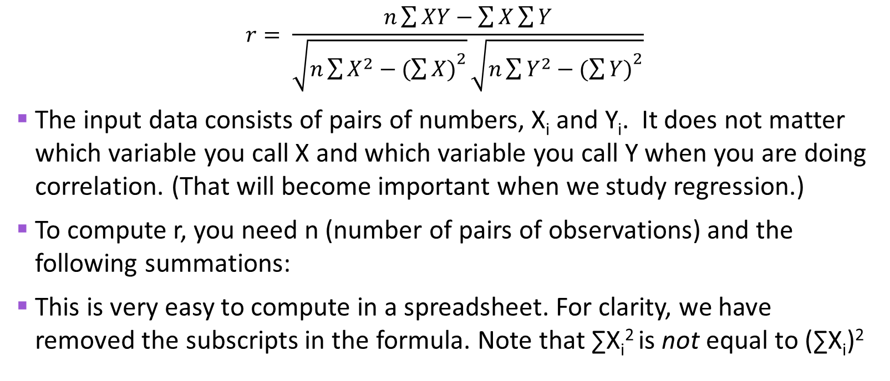
Computing the Correlation Coefficient
$$r= \frac{n\sum{XY−\sum{X\sum{Y}}}}{\sqrt{n\sum{X^{2}−{(\sum{X)}}^{2}}}\sqrt{n\sum{Y^{2}−{(\sum{Y)}}^{2}}}}$$
The input data consists of pairs of numbers, X_{i} and Y_{i}. It does not matter which variable you call X and which variable you call Y when you are doing correlation. (That will become important when we study regression.)
To compute r, you need n (number of pairs of observations) and the following summations:
This is very easy to compute in a spreadsheet. For clarity, we have removed the subscripts in the formula. Note that ∑X_{i}² is not equal to (∑X_{i})²
∑X_{i} | ∑Y_{i} | ∑ X_{i}Y_{i} | ∑X_{i}² | ∑Y_{i}²

Slide 11
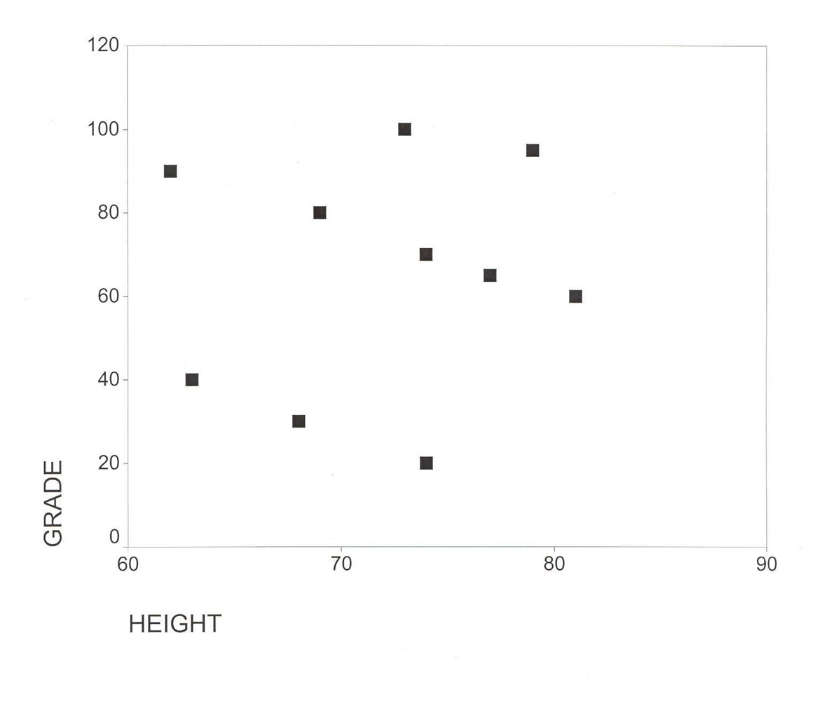
Example 1: Grade and Height
Y (Grade) | 100 | 95 | 90 | 80 | 70 | 65 | 60 | 40 | 30 | 20
X (Height) | 73 | 79 | 62 | 69 | 74 | 77 | 81 | 63 | 68 | 74
∑X_{i} = 720
∑Y_{i} = 650
∑X_{i}Y_{i} = 46,990
∑X_{i}² = 52,210
∑Y_{i}² = 49,150

Slide 12
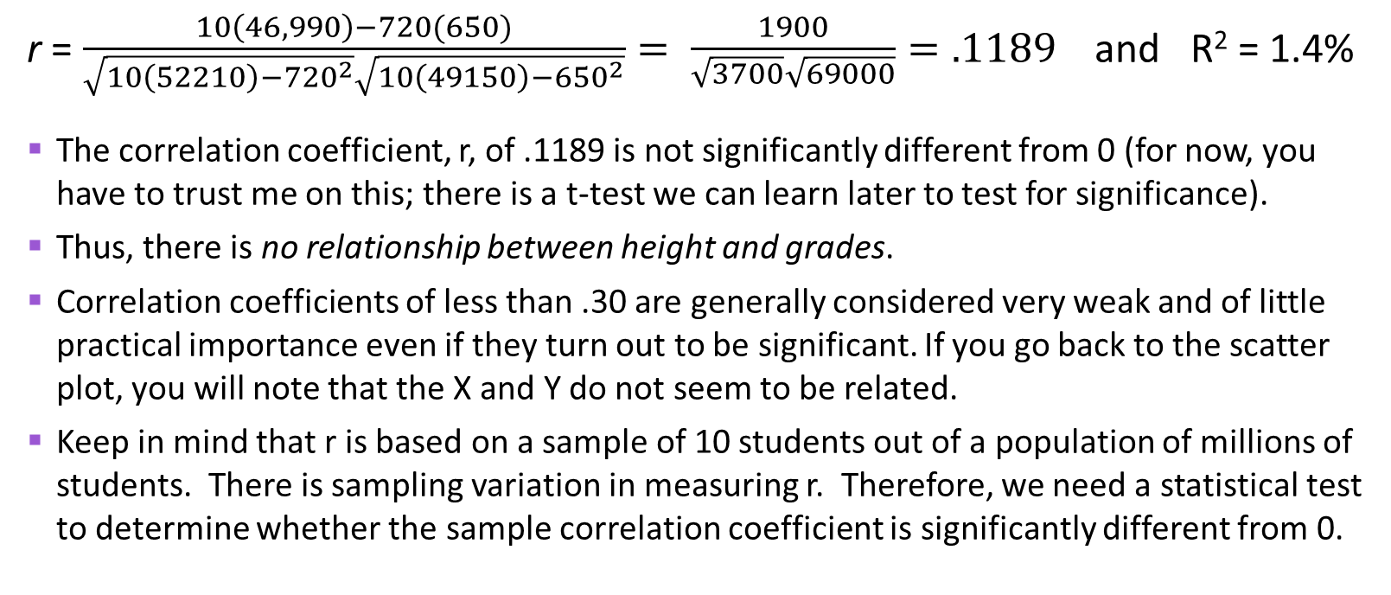
Example 1: Grade and Height
r = $\frac{10\left(46,990\right)−720(650)}{\sqrt{10\left(52210\right)−{720}^{2}}\sqrt{10\left(49150\right)−{650}^{2}}}= \frac{1900}{\sqrt{3700}\sqrt{69000}}=.1189$ and R² = 1.4%
The correlation coefficient, r, of .1189 is not significantly different from 0 (for now, you have to trust me on this; there is a t-test we can learn later to test for significance).
Thus, there is no relationship between height and grades.
Correlation coefficients of less than .30 are generally considered very weak and of little practical importance even if they turn out to be significant. If you go back to the scatter plot, you will note that the X and Y do not seem to be related.
Keep in mind that r is based on a sample of 10 students out of a population of millions of students. There is sampling variation in measuring r. Therefore, we need a statistical test to determine whether the sample correlation coefficient is significantly different from 0.

Slide 13
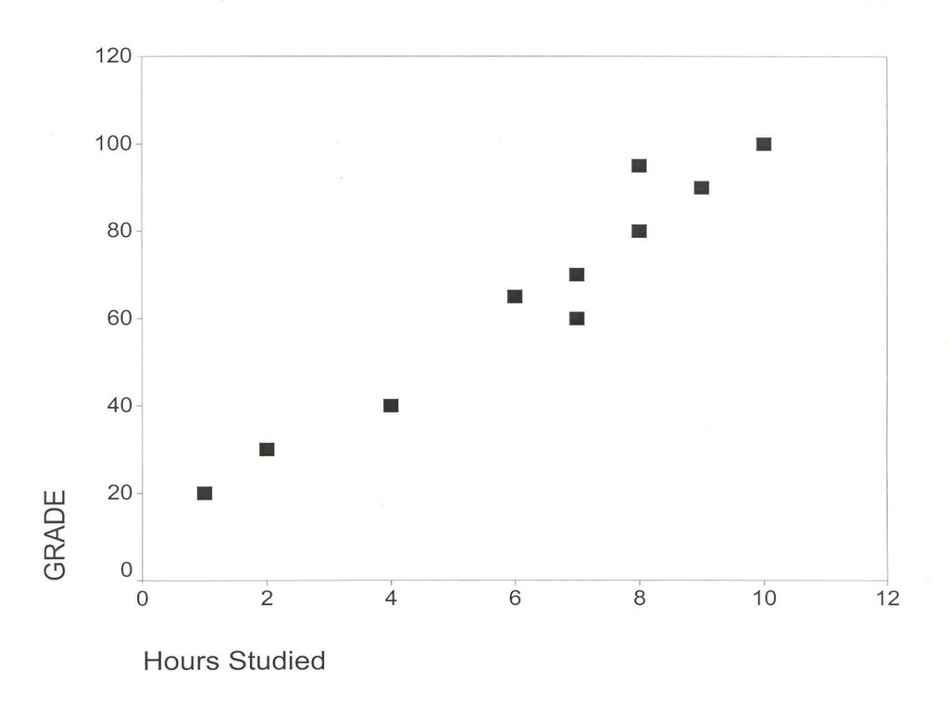
Example 2: Grades and Hours Studied
Y (Grade) | 100 | 95 | 90 | 80 | 70 | 65 | 60 | 40 | 30 | 20
X (Hours Studied) | 10 | 8 | 9 | 8 | 7 | 6 | 7 | 4 | 2 | 1
∑X_{i} = 62
∑Y_{i} = 650
∑X_{i}Y_{i} = 4,750
∑X_{i}² = 464
∑Y_{i}² = 49,150
BETTER!

Slide 14
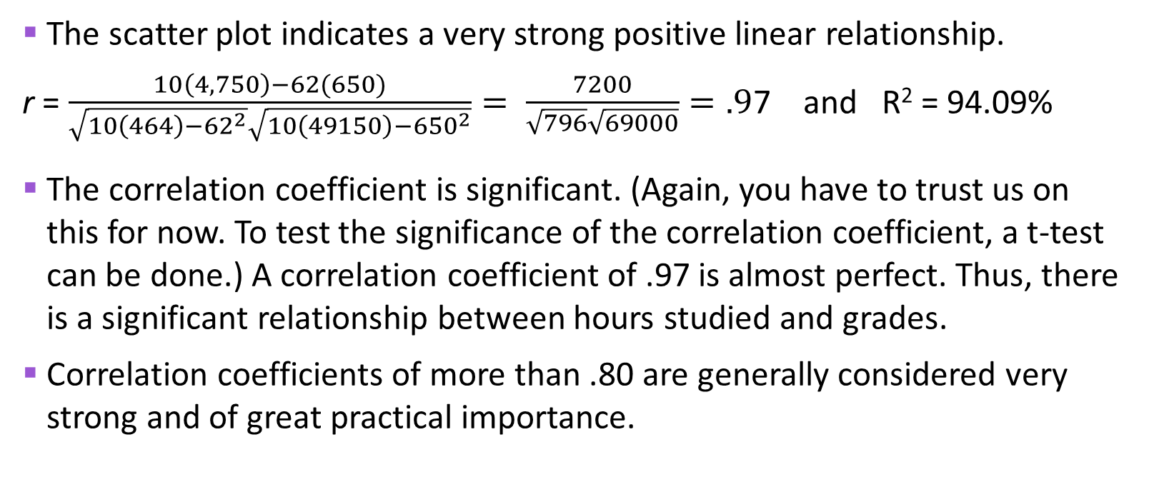
Example 2: Grades and Hours Studied
The scatter plot indicates a very strong positive linear relationship.
r = $\frac{10\left(4,750\right)−62(650)}{\sqrt{10\left(464\right)−{62}^{2}}\sqrt{10\left(49150\right)−{650}^{2}}}= \frac{7200}{\sqrt{796}\sqrt{69000}}=.9$7 and R² = 94.09%
The correlation coefficient is significant. (Again, you have to trust us on this for now. To test the significance of the correlation coefficient, a t-test can be done.) A correlation coefficient of .97 is almost perfect. Thus, there is a significant relationship between hours studied and grades.
Correlation coefficients of more than .80 are generally considered very strong and of great practical importance.

Slide 15
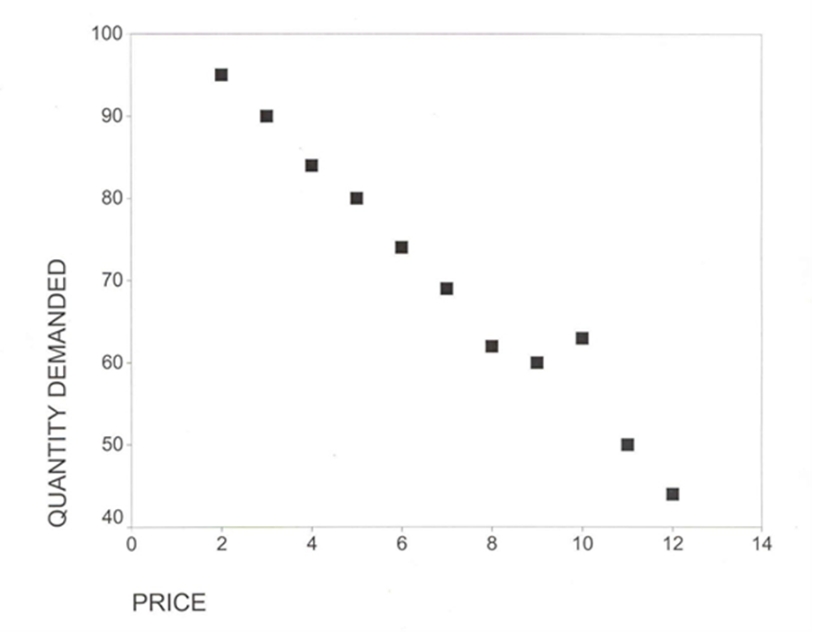
Example 3: Price and Quantity
X (Price) | Y (Demand)
$2 | 95
3 | 90
4 | 84
5 | 80
6 | 74
7 | 69
8 | 62
9 | 60
10 | 63
11 | 50
12 | 44
∑X_{i}=77 | ∑Y_{i}=771
∑X_{i}Y_{i}=4,867
∑X_{i}² =649
∑Yi² =56,667

Slide 16
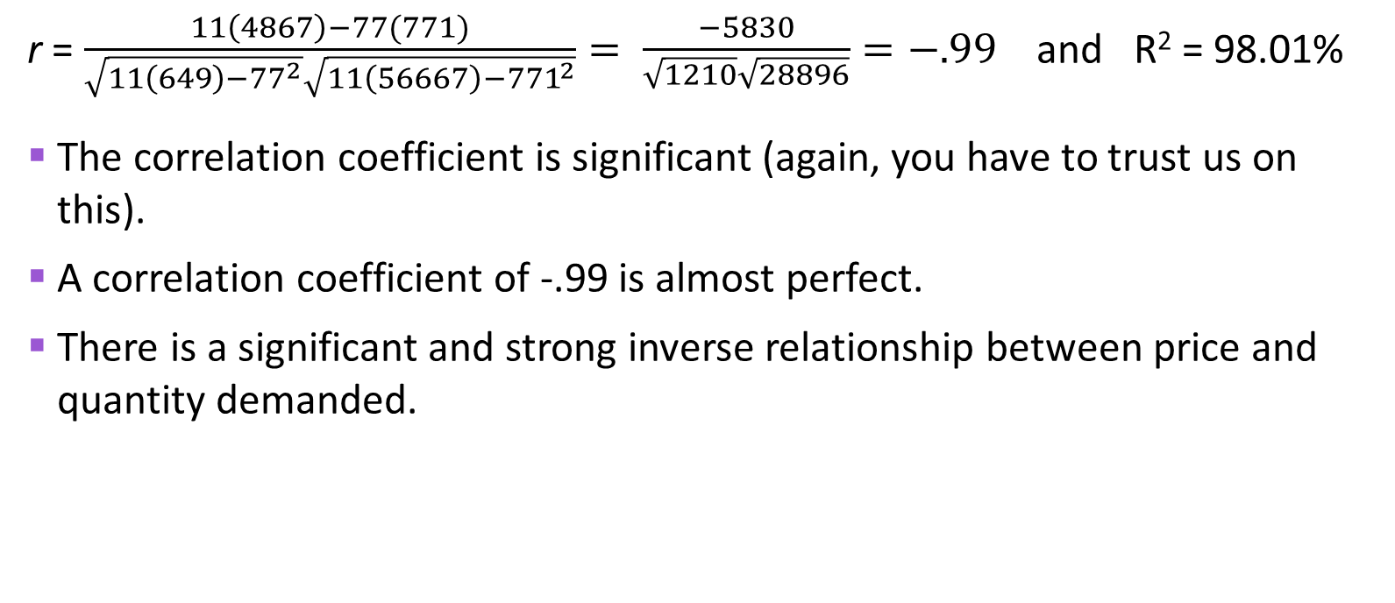
Example 3: Price and Quantity (cont’d)
r = $\frac{11\left(4867\right)−77(771)}{\sqrt{11\left(649\right)−{77}^{2}}\sqrt{11\left(56667\right)−{771}^{2}}}= \frac{−5830}{\sqrt{1210}\sqrt{28896}}=−.99$ and R² = 98.01%
The correlation coefficient is significant (again, you have to trust us on this).
A correlation coefficient of -.99 is almost perfect.
There is a significant and strong inverse relationship between price and quantity demanded.

Slide 17
Example 4: Attractiveness and Salary
Attractiveness Score | Starting Salary ($000)
0 | 20
1 | 24
2 | 25
3 | 26
4 | 20
5 | 30
6 | 32
7 | 38
8 | 34
9 | 40
The higher the attractiveness score, the more attractive the employee.
Is there a relationship between employee attractiveness and salary?
n =10
∑X_{i} = 45
∑Y_{i} = 289
∑X_{i}Y_{i} = 1,472
∑X_{i}² = 285
∑Y_{i}² = 8,801

Slide 18
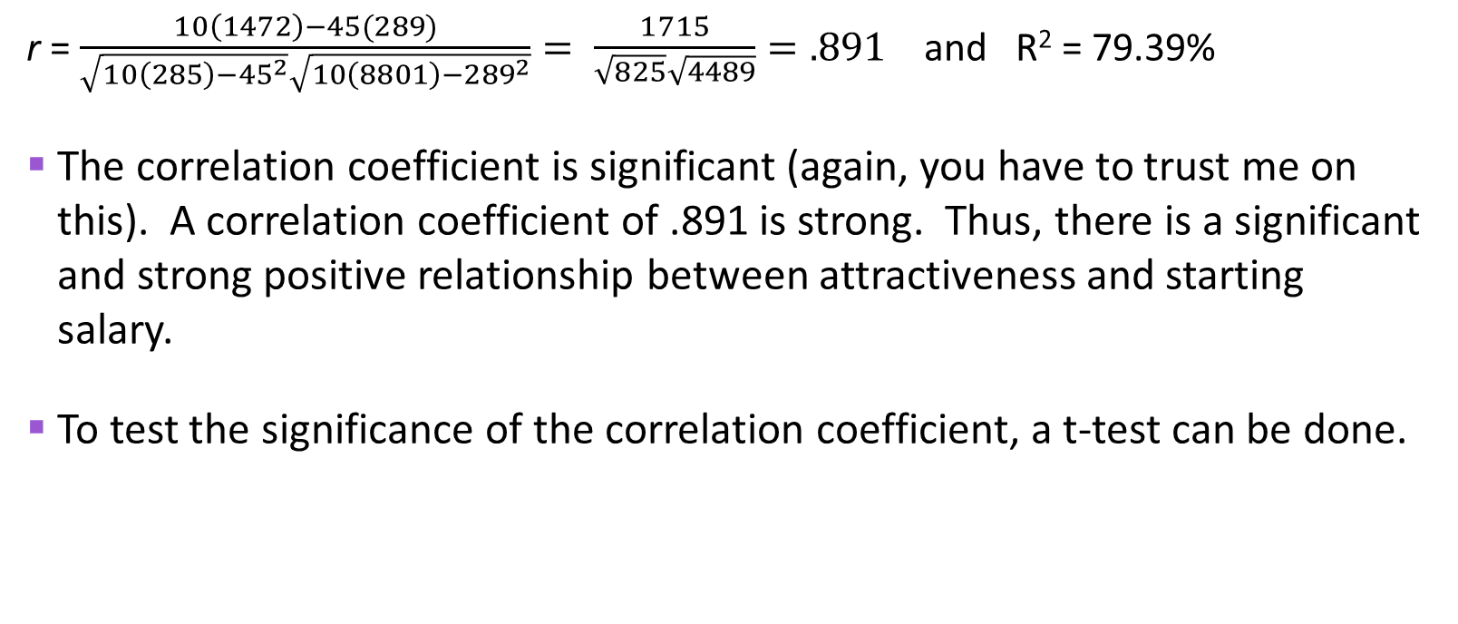
Example 4: Attractiveness and Salary
r = $\frac{10\left(1472\right)−45(289)}{\sqrt{10\left(285\right)−{45}^{2}}\sqrt{10\left(8801\right)−{289}^{2}}}= \frac{1715}{\sqrt{825}\sqrt{4489}}=.891$ and R² = 79.39%
The correlation coefficient is significant (again, you have to trust me on this). A correlation coefficient of .891 is strong. Thus, there is a significant and strong positive relationship between attractiveness and starting salary.
To test the significance of the correlation coefficient, a t-test can be done.

Slide 19
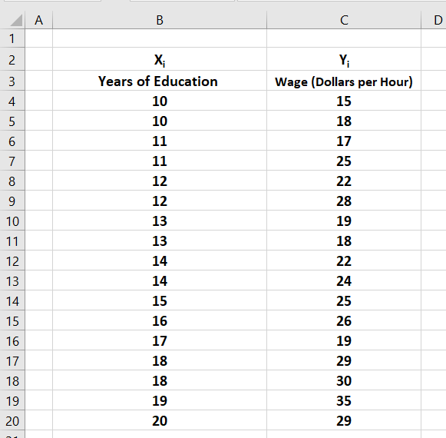
Example 5: Education and Wages
Are education and wages earned related?
Go to Function Wizard and select correlation (CORREL). Array1 is B4: B20 Array2 is C4: C20
We use MS Excel to solve this problem.
Correlation Coefficient, r = | 0.7264
To calculate the r², simply square r. | r-squared is equal to .5277 or 52.77%
Excel can give us the scatter plot too!

